Slide 1
Towards Automatic Annotation and Detection of Fake News
Mohammad Majid Akhtar†
Bibhas Sharma†
Ishan Karunayake†
Rahat Masood†
Muhammad Ikram‡
Advisor: Salil S. Kanhere†
† The University of New South Wales (UNSW), Sydney, Australia
‡ Macquarie University, Sydney Australia
4th October 2023

Slide 2

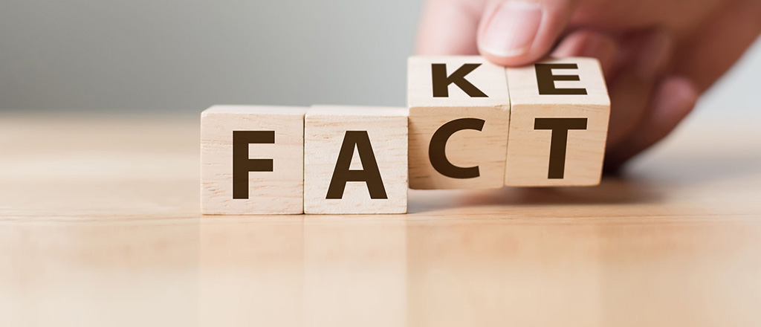
Information Pathologies…
Source: Google Images

Slide 3
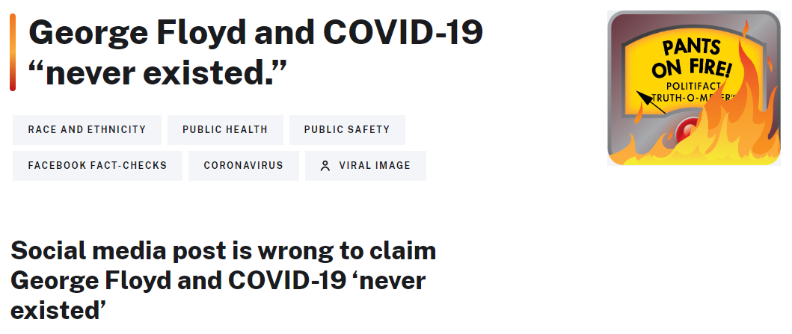
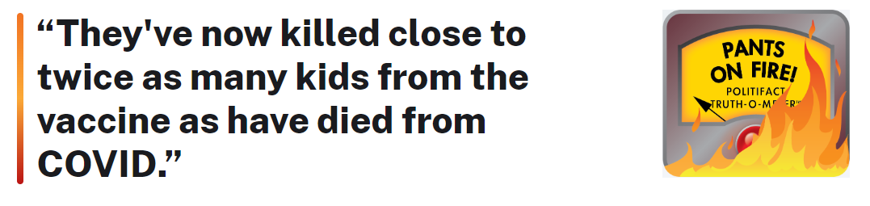

COVID-19 Misinformation
For example…
Source: PolitiFact
Fake
1
As it spreads, it reinforces and amplifies our prejudices.
2
Human are major collaborators of false information, but Bots do accelerate it.
3
It affects everyone and differently [Starbird et al. 2019]

Slide 4


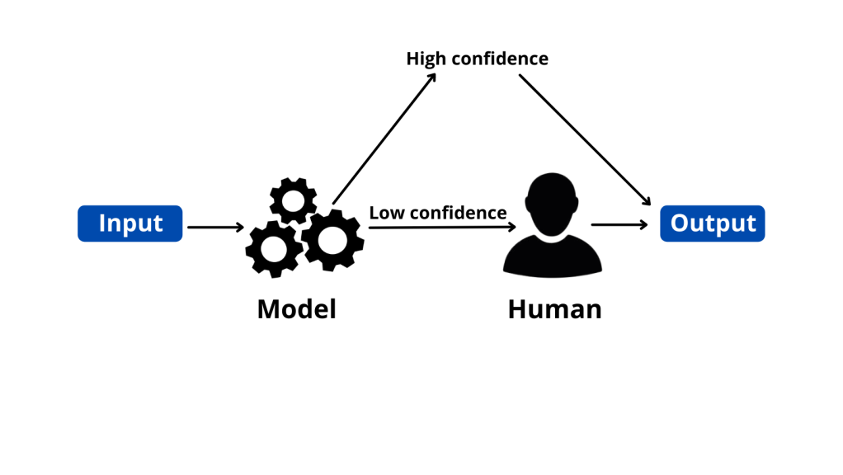
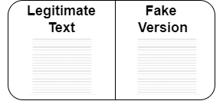
Background and Current Works
[Zhang et al. WWW‘18]
[Wang et al. AAAI’ 19]
[Bonet Jover, 2021]
Source: Google Images
[Rosas et al. ACL’18]

Slide 5



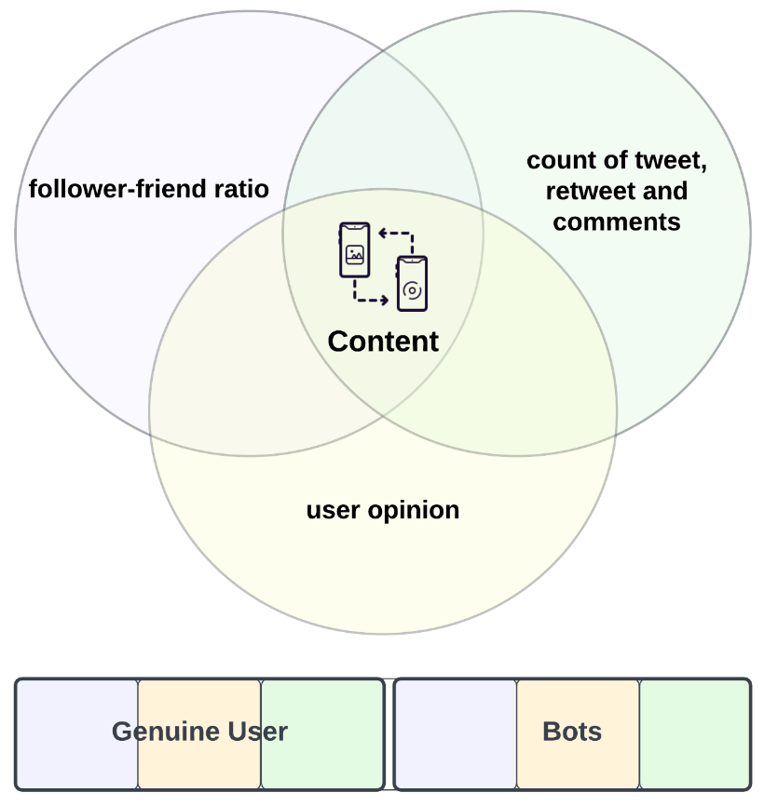


Challenges
Manual Annotation
Hard to scale
Incur delays
Lack of large Labeled Dataset To build a robust fake news detection model
No work that takes both (false information and bots)
into consideration
Source: Google Images

Slide 6
Contributions
We propose an automatic annotation model to annotate the textual content of posts using verified fact-checked statements (supporting statements).
We design and develop an ensemble stack model to detect fake information
We investigate the impact of bots in our dataset with regards to misinformation

Slide 7
Methodology

Slide 8
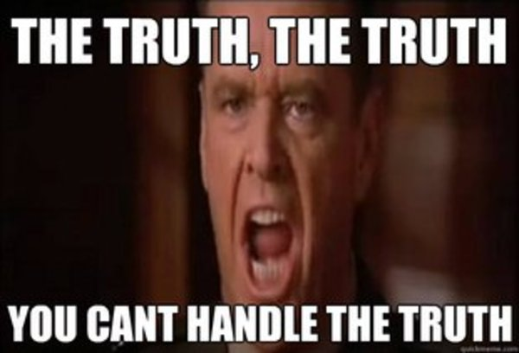
Truth Matters! Fact Matters!
Source: A Few Good Men

Slide 9
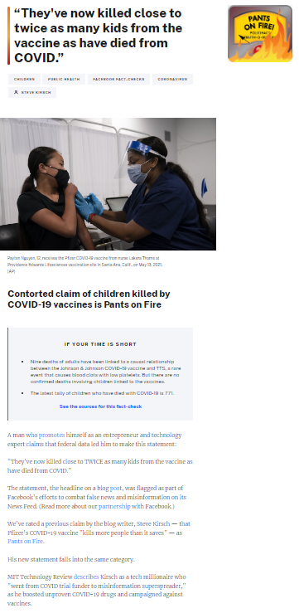



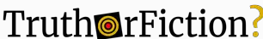
Fact-Checked Articles ‘Supporting Statements’
Fact-Checking Organizations
Title
Verdict
Body Text
and more…
Source: Fact-Checking Organizations

Slide 10
Methodology – I
Annotation (Stage A)
Text (Tweets)
Supporting Statements (Title + Body Text)
Tweets
Supporting Statements
BERT
BERT
Problem: Cosine similarity might miss out the best supporting statement as it only runs till the first threshold is found.
Each Tweet having 768 dimension Sentence embedding
Each Statement having 768 dimension Sentence embedding
cosine_similarity ( , ) ≥ Threshold
Verdict of Tweet ← Verdict of Supporting statement

Slide 11
Methodology – I
Annotation (Stage B)
Text (Tweets)
Supporting Statements (Title + Body Text)
Best Match Algorithm
relevance score = f (t, s)
‘n’ candidate statements
Top rank ‘s’ statements
……
……
(CTM) Contextual Text Matching
……
……
[Vo et al. EMNLP’20]

Slide 12
Methodology – I
Annotation (Stage B)
For every tweet:
Let’s say 3 top-rank supporting statements
For each statement, we have
Relevance score between tweet and statement
Cosine similarity between tweet and statement
Verdict of the supporting statement
cos_score | rel_score | verdict
cs_1 | rel_score1 | Fake
cs_2 | rel_score2 | Fake
cs_3 | rel_score3 | Real
To reduce computational efforts
We can perform this with two settings:
With body text of the supporting statement (Title + Body Text)
Without body text (Title)
Regular Majority Voting
Weighted Majority Voting
cosine_sim_sum = cs_1 + cs_2 + cs_3
Final Verdict = Fake (2 Fake and 1 Real)
If verdict = Fake; fake_score = score_fake + (cosine_sim[i]/cosine_sim_sum) ∗ rel_score[i]
else: real_score = score_real + (cosine_sim[i]/cosine_sim_sum) ∗ rel_score[i]
fake_score ≥ real_score Verdict ← fake else real

Slide 13
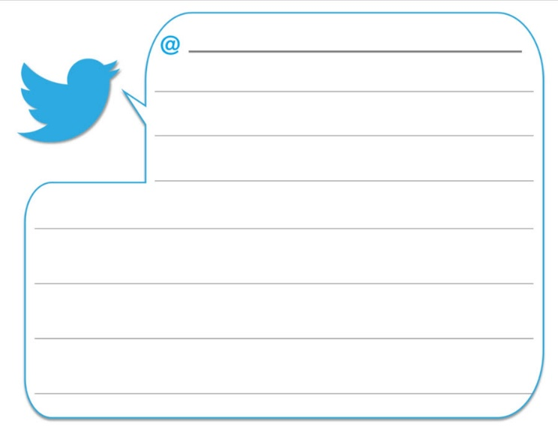
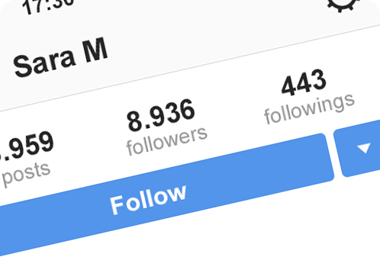
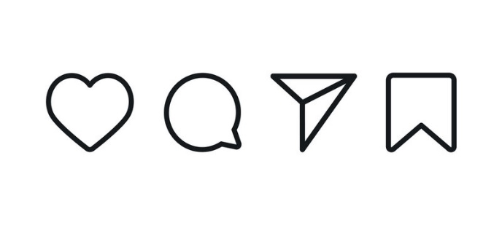
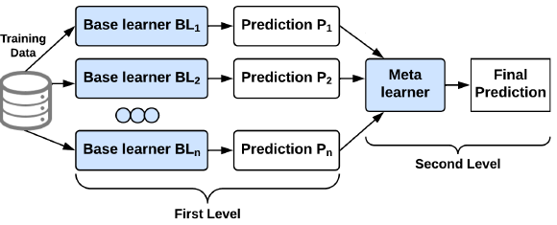
Methodology – II
Fake News Detection Model
Feature Engineering
Number of URLs
Number of mentions
Textual content features
[Patwa et al. 2021]
[Ahmed et al. 2017]
[Wang et al. 2021]
To get textual representations:
Vectorizer-based (TF-IDF)
Transformer-based (BERT)
Tweet-level features
[Al-Rakhami et al. 2020]
User-level features
[Al-Rakhami et al. 2020]
Model Building
We aim to improve the accuracy by combining different classifiers
We tend to use all three features combined.

Slide 14
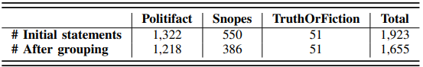



COVID-19 as a use-case ‘Infodemic’
Grouped -> (Pants on Fire, False, Misattributed) Removed -> (unknown, unproven)
Collecting Supporting Statements (COVID-19)
Data Collection Description:
(June-August 2021) → Collected Duration
1st January 2020-21st June 2021 (533 days)
Four Geolocations: US, UK, India, Australia
Excluded non-English tweets
10.22 Million Tweets
Collect Tweets related to COVID-19
Labeled their tweets on COVID-19 as real
Annotate (label tweets)

Slide 15
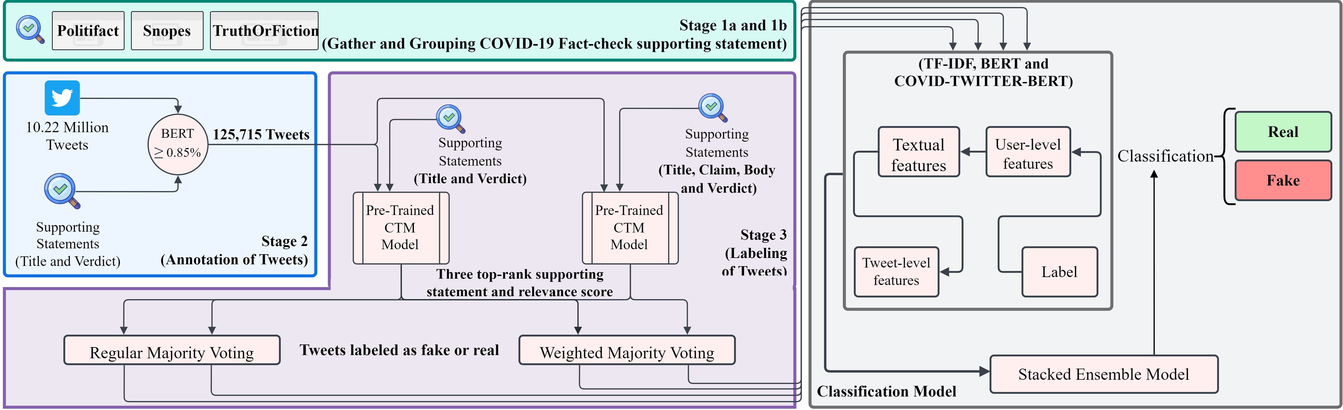
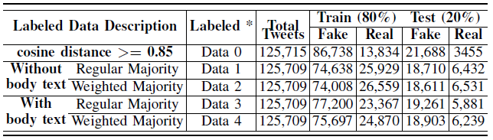
Our Results – I (Annotation)
Two Properties:
Threshold ↑ Accuracy ↑
Threshold ↑ #Annotated Tweets ↓
See our paper for details

Slide 16
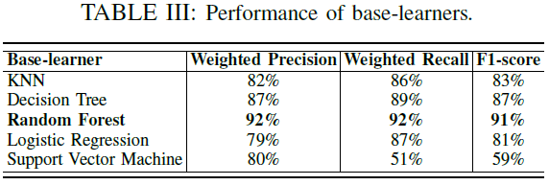
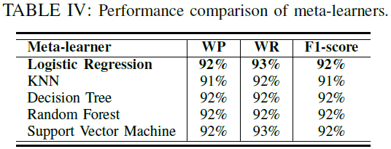
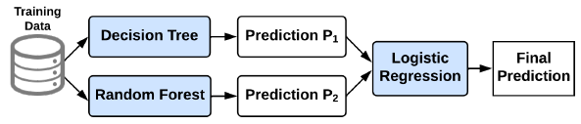
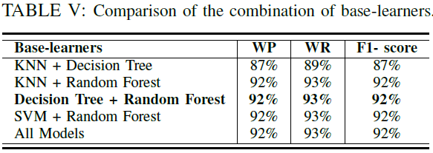
Our Results – I (Model Building)
SVM

Slide 17
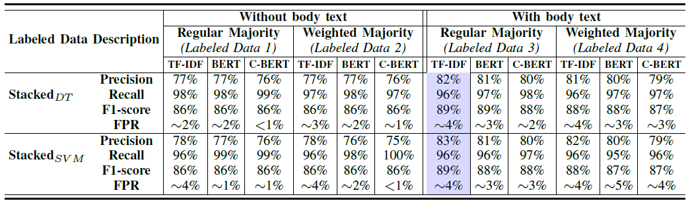
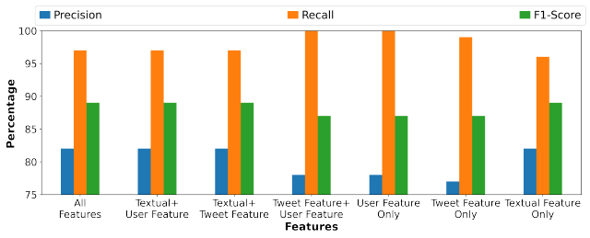
Our Results – I (Detection)

Slide 18
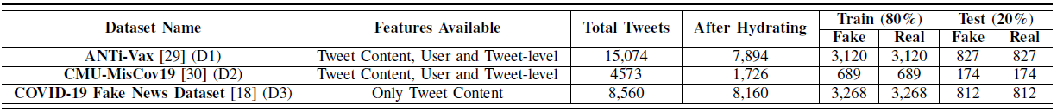
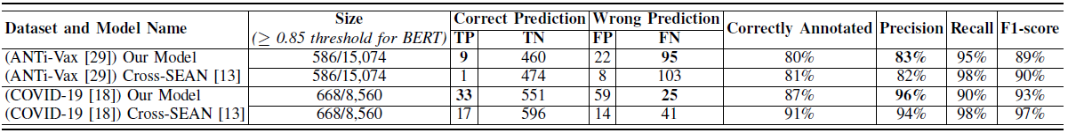
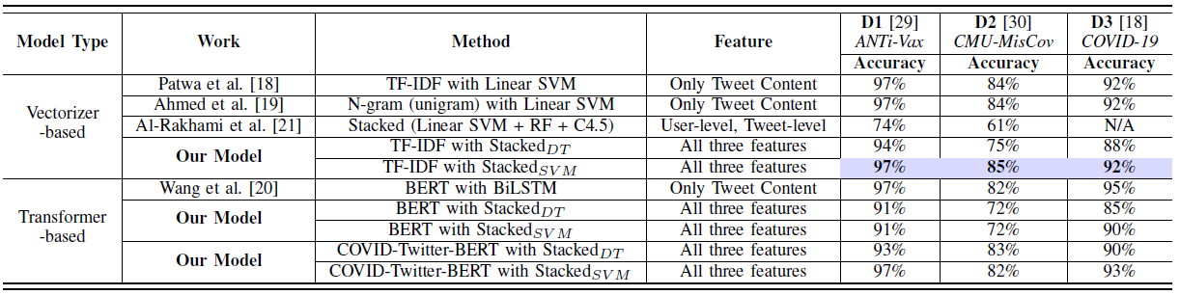
Our Results – II (Public Datasets)
1. Our Annotation Model Performance
2. Our Fake News Detection Model Performance

Slide 19
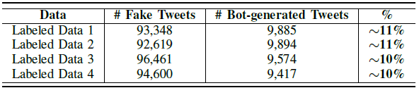
Impact of Bots
Two Hypothesis:
H1: Bots have an active role in spreading misinformation (in our dataset)
H2: Bots are most active during misinformation campaigns compared to other times
Used BotometerLite with >=0.5 as threshold for Bot _{[Yang et al. AAAI’20]}
0
1
Human
Bot
H1: Bots have an active role in spreading misinformation

Slide 20
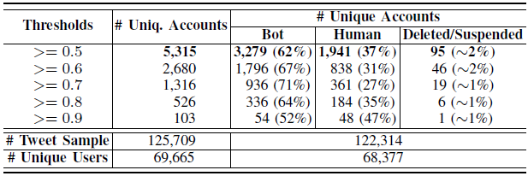
Impact of Bots
We compared unique accounts from two-time durations using different bot thresholds:
June-August 2021 (Actual Data Collection) Covering major COVID-19 duration
August 2022 (One year later) Covering post-COVID-19 duration
As per August 2022 Botometer Results
H2: Bots are most active during misinformation campaigns compared to other times

Slide 21

Limitations and Future Perspective
1.0
7.0
1.0
0.9 0.8
Pants on Fire
False
1.0
0.8
Misattributed
Imbalanced Annotation
Different weights for labels
Not taken User Truth Value in account

Slide 22
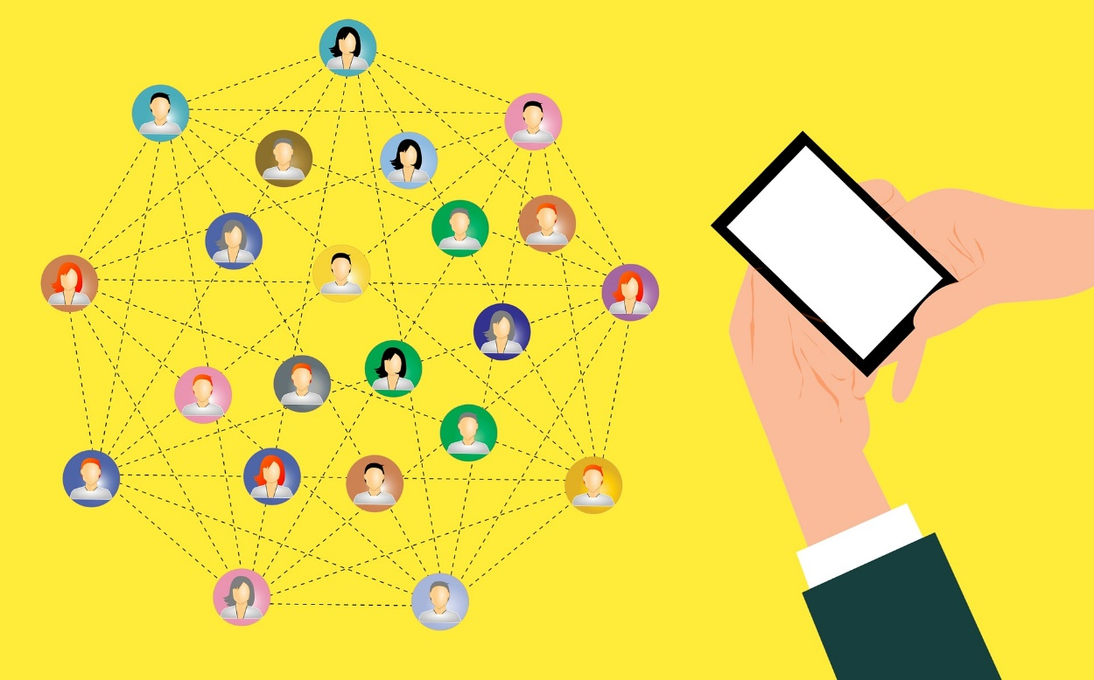
Conclusion
Source: Google Images

Slide 23
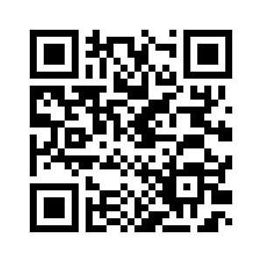
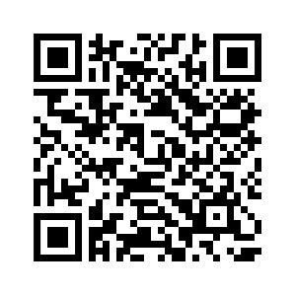
Find this paper at
Thank you for listening! Questions?
Mohammad Majid Akhtar
majid.akhtar@unsw.edu.au
Or find me on LinkedIn

Slide 24
References
Starbird, K., Arif, A., & Wilson, T. (2019). Disinformation as collaborative work: Surfacing the participatory nature of strategic information operations. Proceedings of the ACM on Human-Computer Interaction, 3(CSCW), 1-26.
A. X. Zhang and et al., “A structured response to misinformation: Defining and annotating credibility indicators in news articles,” ser. WWW, 2018.
Y. Wang and et al., “Weak supervision for fake news detection via reinforcement learning,” in AAAI, 2019.
A. Bonet-Jover, “Semi-automatic annotation proposal for increasing a fake news dataset in spanish,” 2021.
V. P´erez-Rosas, B. Kleinberg, A. Lefevre, and R. Mihalcea, “Automatic detection of fake news,” in ACL, 2018.
Nguyen Vo and Kyumin Lee. 2020. Where Are the Facts? Searching for Fact-checked Information to Alleviate the Spread of Fake News. In Proceedings of the 2020 Conference on Empirical Methods in Natural Language Processing (EMNLP), pages 7717–7731, Online. Association for Computational Linguistics.
Patwa, P., Sharma, S., Pykl, S., Guptha, V., Kumari, G., Akhtar, M. S., ... & Chakraborty, T. (2021). Fighting an infodemic: Covid-19 fake news dataset. In Combating Online Hostile Posts in Regional Languages during Emergency Situation: First International Workshop, CONSTRAINT 2021, Collocated with AAAI 2021, Virtual Event, February 8, 2021, Revised Selected Papers 1 (pp. 21-29). Springer International Publishing.
H. Ahmed, I. Traore, and S. Saad, “Detection of online fake news using n-gram analysis and machine learning techniques,” in ISDSDCE, 2017.
Y. Wang, Y. Zhang, X. Li, and X. Yu, “Covid-19 fake news detection using bidirectional encoder representations from transformers-based models,” arXiv preprint arXiv:2109.14816, 2021.
M. S. Al-Rakhami and A. M. Al-Amri, “Lies kill, facts save: Detecting covid-19 misinformation in twitter,” IEEE Access, vol. 8, 2020.
M. Aldwairi and A. Alwahedi, “Detecting fake news in social media networks,” PCS, vol. 141, 2018.

